Slide 1

UNIT 10B
SO DO I.
ME NEITHER.

Slide 2
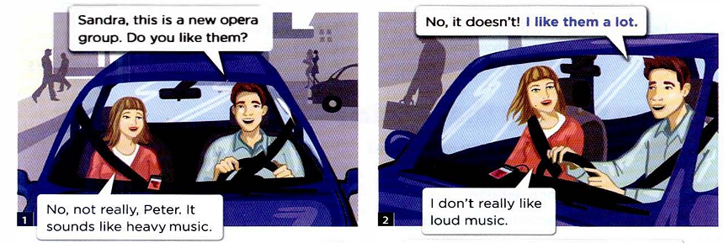
CONVERSATION
I like to listen to rock music. And you, Sandra?
Me neither, Sandra.
So do I. I really love it.
But I don't like to listen to opera. It’s so boring.
A: What do you like to listen to, Peter?
B: I like to listen to rock music. And you, Sandra?
A: So do I. I really love rock. But I don't like to listen to opera.
B: Me neither, Sandra.

Slide 3
PAIR WORK
A: What do you want to buy? A: Do you want to buy a skirt?
B: I want to buy a dress. B: No, I don’t want to buy a skirt.
Want to …/ Like to …
buy | a tie, a coat
eat | beef, pork
drink | soda, milk
wear | a necklace, a bracelet
play | the piano, the guitar
teach | English, Vietnamese
drive | a Honda, a Toyota
study | math, computer science
use | a pencil, a marker
ride | a motorcycle, a horse
learn | grammar, pronunciation
borrow | books, money
Have to … / Need to …
write | a report, a letter
read | the textbook, the news
count | the chairs, the people
save | money, time
cut | oranges, potatoes
paint | the door, the wall
sell | the car, the house
lend | the cat, the dog
look at | the map, the clock
record | a lesson, a song
feed | the dog, the cat
iron | the pants, the jeans
observe | the stars, the moon
show | the photos, the videos
conduct | music, a class
build | houses, bridges
store | rice, meat
clean | the desk, the TV
sign | a contract, a letter
review | the vowels, the consonants

